Slide 1



iMAP
towards low-dose iL2 Market APproval
for autoimmune diseases
ANR- 16-RHUS-0001
17/01/2020
Notes:
1

Slide 2
From data production to data integration
Caroline Peltier, François-Xavier Lejeune, Ivan Moszer, Encarnita Mariotti-Ferrandiz
2
Comité Scientifique iMAP - .../2019
Notes:
2

Slide 3
Ordre du jour
Etats des lieux des bio-collections
Tâches définies par partenaire
Questions biologiques
Analyses: qui, quoi et comment?
Infrastructure et partage de données: update

Slide 4
WP4- Bio-collections
TRIALS | LUPIL-2 | MS-IL2 | DIABIL-2 | HEALTH-IL2 | FACIL-2
Patients # | 84 | 30/30 | 132/138 | 6/40 | 10
Flow Cytometry sample # | 420 | 190 (Frozen PBMC) | 319 for Paris (Frozen PBMC) | All In real time +pStat5 | Q1 2020
Transcriptome Repertoire Treg/Teff RNA sample # | 587 (each techno)
Cytokines sample # | 420 | 206 (Plasma collected) | 330 for Paris (Plasma collected)
Microbiota Sequenced sample # | 184 | 86 | 37 | 0
 |  | End of the Follow up Q2 2020 | Other centers: samples shipment to schedule

Slide 5
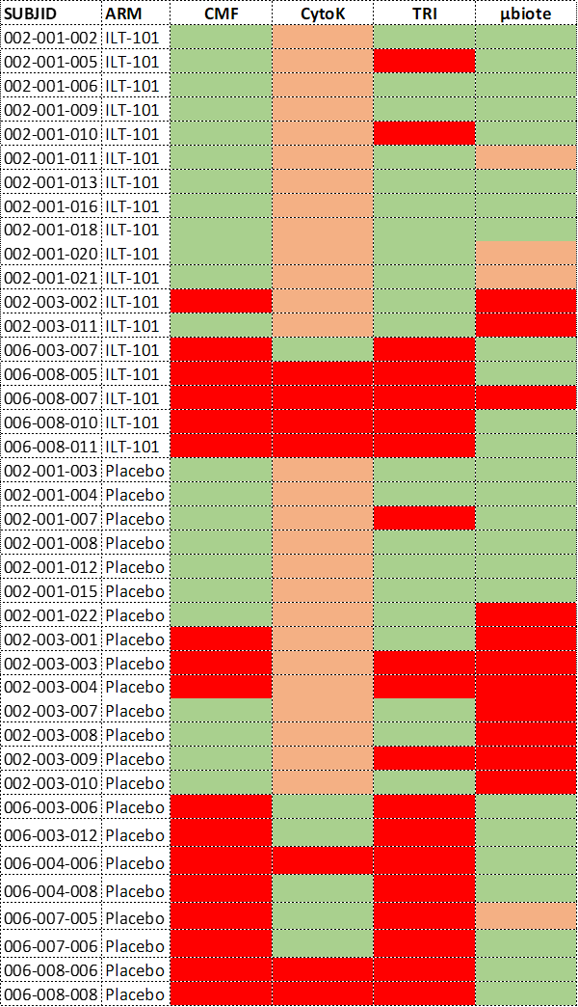
WP4- Bio-collections
Bulgaria and Mexico
All without Bulgaria and Mexico
OK
Only Baseline for µBiota
NO
Cytokines: Plasma frozen but not assayed

Slide 6
Data availability – LUPIL-2 – Expected and currently available
Data availability – LUPIL-2 – To come by 2020 Q1 and Q2

Slide 7
les tâches de chaque partenaire dans le WP3 (document soumis)
Description | Partenaires | Type d’analyses envisagées
Task 3.1 Identification of cell- and serum-derived immune signatures | APHP/SU, ILTOO, Ligan-MP | Analyses univariées
Task 3.2 Identification of Treg and Teff functional transcriptomic signatures | APHP/SU, ILTOO, Ligan-MP | Analyses univariées
Task 3.3 Identification of Treg and Teff TCR signatures | APHP/SU | Analyses univariées
Task 3.4 Identification of microbial signatures relevant for IL2 treatment | MGP | Analyses univariées
Task 3.5 Toward integrative biomarker discovery | IHU-A-ICM | Analyses multivariées
Task 3.6 Mechanisms of actions of ld-IL2 (interprétation biologique des résultats d’analyses univariées) | All partners | Analyses univariées
Task 3.7 Towards definitions of tools for immunomonitoring and theranostics | IBC/ILTOO | NA

Slide 8
les tâches de chaque partenaire dans le WP3 (revues en séance)
Description | Partenaires | Type d’analyses envisagées
Task 3.1 Identification of cell- and serum-derived immune signatures | APHP/SU, ILTOO | Analyses univariées
Task 3.2 Identification of Treg and Teff functional transcriptomic signatures | APHP/SU, ILTOO | Analyses univariées
Task 3.3 Identification of Treg and Teff TCR signatures | APHP/SU | Analyses univariées
Task 3.4 Identification of microbial signatures relevant for IL2 treatment | MGP, ILTOO | Analyses univariées
Task 3.5 Toward integrative biomarker discovery | IHU-A-ICM, APHP/SU | Analyses multivariées
Task 3.6 Mechanisms of actions of ld-IL2 (interprétation biologique des résultats d’analyses univariées) | All partners | Analyses univariées
Task 3.7 Towards definitions of tools for immunomonitoring and theranostics | IBC/ILTOO | NA

Slide 9
Questions biologiques:
Objectives initially planned
Define biological questions for iMAP, and list potential expectations
Practical questions for statistical analyses
First ideas of who does what

Slide 10
Possible axes for biological questions
Descriptive analysis: What are the composition of our groups?(characteristics)
group evaluation at baseline
Placebo vs treated
Age (continuous variable or range)
Gender (but 90% women)
Treatment
Country of recruitment or Region of recruitment
Ethnicity (first to evaluate the distribution)
Multigroup analysis for bias correction (by PCA)
10

Slide 11
Possible axes for biological questions
Exploratory analysis: What are the main reasons of biological variability in the experiment ? (presence of groups, outliers… ?)
Discriminant analysis: (signature, biomarkers...)
What is the IL2 action? (IL2 vs. Placebo)
Evaluate the heterogeneity of the IL2 action
How to define IL2 response? (Respondant vs. Non-respondant)
Placebo effect? (placebo respondant vs placebo non respondant)
11

Slide 12
Multi-scale and multi-time
These axes can be investigated at different scales;
By variable (univariate)
By block (multivariate)
Multiblock
… but also at different times
By timepoint
Comparison to baseline (paired analyses)
Priority for all but microbiome: d5 vs Baseline > peak of biological response
Priority for microbiome: M3 vs baseline
Across timepoints
AUC/slope, for univariate analysis
Correlation, multiway analysis for multivariate analysis

Slide 13
Expectations for LUPIL2
 | Cytometry | Transcr (RNASeq) | Cytokines | Repertoire TCR | Microbiote | Clinique
IL2 action | ↑ Treg (Foxp3+ cells); ↑ NK CD56bright | ↑ signature cell cycle inTreg? | ↑ IL2RA+ | No clear expectations | No clear expectations | NA
IL2 responder (clinically) | ↑ CTLA4 | ↓ inflammatory signature (cf papier a transmettre GDJ) ↑ pSTA5 expression among Treg | ↑ IL2RA+ | No clear expectations | ↑ tolerogen species; ↓inflammatory species in respondent compared either with non-respondents or the baseline Dysbiose in non-repondents

Slide 14
Other hypotheses to test?
Clinical variables of interest?
Déterminer si il y a des corrélations entre les variables cliniques avec les résultats des analyses descriptives de façon systématique
Can we detect a lupus flare based on the biological data
Analyse
Critère de définition
Potential links between blocks?
Cytometry/cytokine/transcriptome
Microbiome/TCR
Clinical with each

Slide 15
Other hypotheses to test?
Preselection of variables for multibloc analysis
Signatures, list of functionally annotated genes,
cell populations (NK CD56Bright, Treg,…)
clinical variables: severity/response
Microbiome - Selection at the level of the genus/families; selection of inflammatory/anti-inflammatory species
TCR - list of enriched data vs theoretical
Descriptive analysis on selected variable
Selected variables for univariate analysis
Relative to Task 3.6. « Mechanisms of action of ld-IL2 » - this applies first on healthil-2
Mechanisms of action and dynamics of Tregs
Cross-talk between Treg dynamics, immune response to ld-IL2 and microbiota
Deciphering Treg and Teff repertoire dynamics and characteristics in healthy donors vs patients

Slide 16
Block- specificities
 | Cytometry | Transcr (RNASeq) | Cytokines | Repertoire TCR | Microbiote | Clinical
Who? | MR | NTC | MR | EMF | DE | JG
Specificity of data | Hierarchical structure of variables & repetition of measures; Duraclone lot; liquid vs lyophilised | Batch effect, fresh vs frozen cells, RIN, concentration | Batch effect | Very sparse, batch effect, fresh vs frozen cells, variable read numbers | Very sparse, Hierarchical structure of variables; country | Bulgaria, heterogeneity of M3/M6 patients (treatment duration)
Dataset(s) in output | Counts or percent, MFI | count | Intensity; concentration | Count; indices; frequencies | Count; indices; frequencies | heterogene
Pretreatment | Manual gating; automated gating (downsampling; clustering; normalization) | Threshold DESeq2 Normalization; correction | Quantile Normalization Correction imputation | Downsampling/normalization | Downsizing (15M read HQ) | ND
Exploration |  | Enrichment; DE | Expression level; DE | Enrichment; specificity

Slide 17
Ideas of analyses
 | By variable | By block | Multiblock
At one given timepoint | summary/t-test (& non parametric) Network DE | PCA/(s)PLS-DA, Random forests? Network DE | RGCCA network DE correlation
Comparison between two timepoints | Same as by timepoints but on the difference between tn and t0
Accross timepoints | Distribution curves by groups, Mixed model with time effect AUC/slope Network DE | PCA with trajectory MANOVA with time effect ? network DE | RGCCA with trajectory ? MANOVA with time effect ? network DE correlation

Slide 18
Next steps
Git for iMAP analyses !!!!!
Github 25€/month for 10 licenses
Zenodo?
Data sharing
Last version sharing : owncloud, github, zenodo, sharepoint
Who does what?
To be discussed at the next meeting (see doodle sent by Caroline A.)

